Slide 1
¡Mariposas!
Realizing Latin@ Academic Empowerment and Socio-Emotional Health
Through Culture and Social Justice

Slide 2
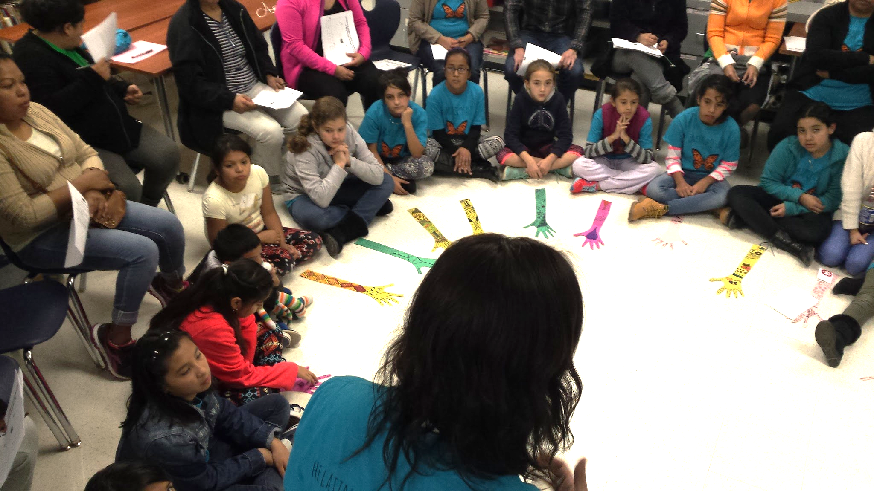
"El Círculo"
You can't find your voice if you don't use it
Name
District
Position
Adjective that best describes you

Slide 3
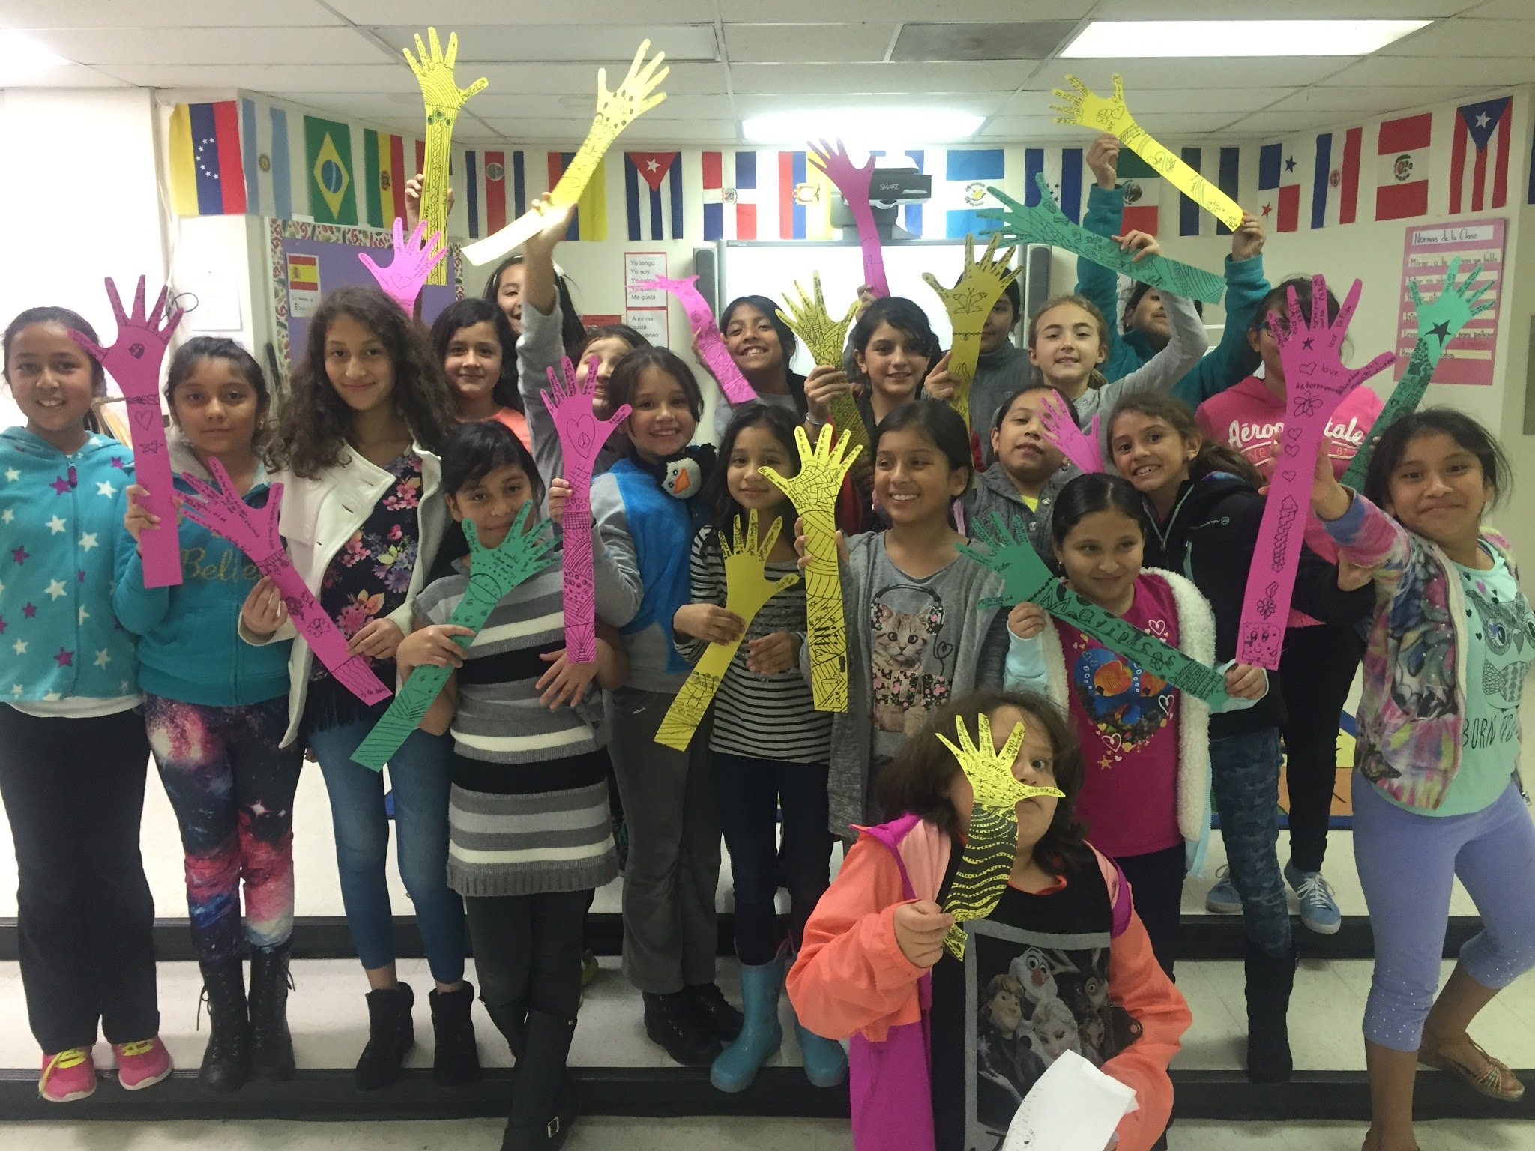
What is Mariposas?
Group empowering young Latinas to take control of their academic performance and socio-emotional health
Culture, tradition, family history, and issues of the Latino diaspora as foundation
Data- driven
Empowerment achieved through development of civic ownership
Parents are parallel participants and collaborators
Exposure to national role models

Slide 4
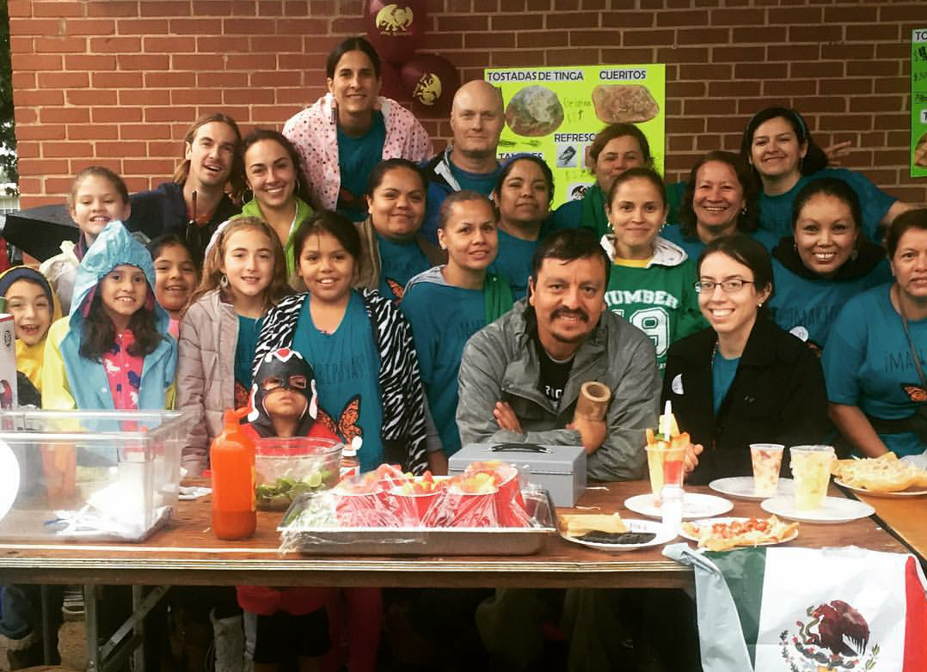
Why share?
Academic growth
Near-perfect attendance students and parents
Improvement in behavior, communication, participation
Increased parent engagement in general school activities
Parents become advocates
Program can be tailored to other populations
Notes:
HR focus- Latino goal
Specify the difference in populations/ regions

Slide 5
WHY

Slide 6
National trends
In the context of projected growth (2050):
⅓ of Latinas don't expect to achieve educational goals
14% dropout rate
Highest teen pregnancy rate of any racial group
Highest rate of suicidal behaviors of all youth groups
Higher rates of mental health issues than
48% of Latino eligible voters turned out to vote
16% of Latinos vs. 27% of non-Latinos regularly volunteer
Sources:
U.S. Census
Listening to Latinas: Barriers to HIgh School Graduation, National Womem's Law Center and Mexican American Legal Defense and Educational Fund
Mental Health: Culture, Race, and Ethnicity: A Supplement to Mental Health: A Report of the Surgeon General
WHY What How

Slide 7
4th Grade Data
4th Grade
National NAEP Math
2015- 24%
2013- 24
2011- 22%
District EOG Math
2015- 43.4%
2014- 41.3%
School EOG Math
2015- 23.3%
2014- 26.7%
Notes:
Percentage at or aboveProficient
the National Assessment of Educational Progress (NAEP) is the largest nationally representativ​e and c​ontinuing assessment of what America's students know and can do in various subject areas. Paper-and-pencil assessments are conducted periodically inmathematics, reading,
Since NAEP assessments are administered uniformly using the same sets of test booklets across the nation, NAEP results serve as a common metric for all states and selected urban districts. The assessment stays essentially the same from year to year, with only carefully documented changes. This permits NAEP to provide a clear p​icture of student academic progress over time.

Slide 8
4th Grade Data
4th Grade
National NAEP Reading
2015- 18%
2013- 17%
2011- 16%
District EOG Reading
2015- 42.8%
2014- 35%
School EOG Reading
2015- 20%
2014- 23.3%

Slide 9
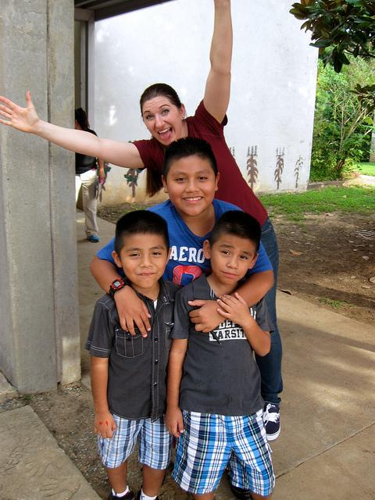
FPG Bilingue
Our school:
Prek-5th TWI Dual Language Spanish/English
Our population:
536 students
57% Latin@
WHY What How
Notes:
Where they from?
What they do?
SEL/legal status
Parent participation
Our struggles

Slide 10
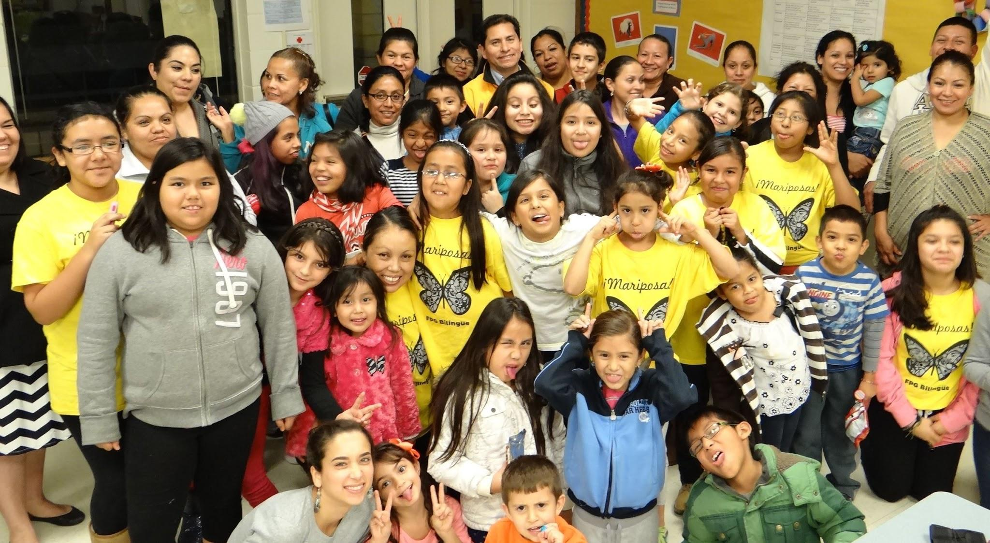
My Latino Trends
What are the Latino trends in your school district?
Historical presence
Academic
Socio-emotional
Engagement
WHY What How

Slide 11
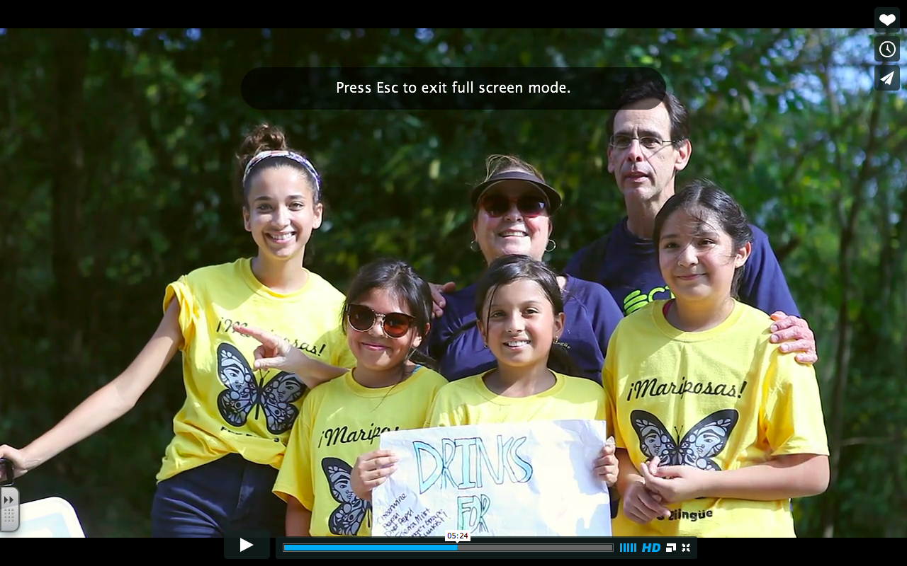
What

Slide 12
Framework
Curricular Focus
+
Civic Ownership
+
Family Engagement
Why WHAT How

Slide 13
Curricular Focus
Reflecting on your population's ecology will provide the focus for your curriculum by:
Identifying target areas
Identifying strengths from which to build on
Why WHAT How

Slide 14
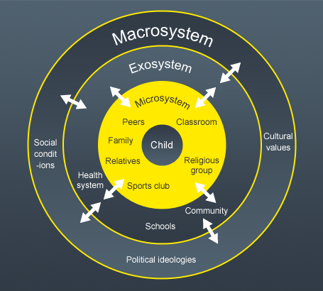
Identifying Strengths and Challenges
Bronfenbrenner's Bioecological Model
Microsystem:
Home
Family
School
Church
Exosystem:
Parent's employment
Divorce
Legal Status
Mesosystem:
How the microsystems impact one another if they're not working together
Macrosystem:
Politics
Cultural Values
Religious beliefs
Economy
Chronosystem:
Issues of time child lives in such as technology, social media, etc

Slide 15
Reflection
Identifying Your Population's Strengths and Needs
Why WHAT How

Slide 16
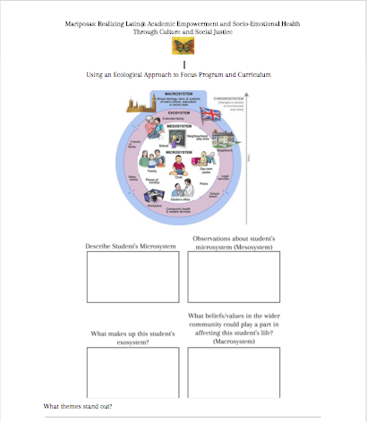
Identifying Needs
Adriana is a 12 year-old student born in Mexico. Adriana is an only child who crossed as an unattended minor at age 10 from Celaya, Guanajuato to join her mother in North Carolina. Adriana's father was abusive to her mother and because of that mom decided to leave in search for a better life. Adriana and her mom share an apartment with another family and sleep in the living room. Adriana's mom has two low- paying jobs. Adriana spends a lot of time by herself when at home. At school she struggles with anger, defiance and sadness. Adriana has a difficult time trusting others.

Slide 17
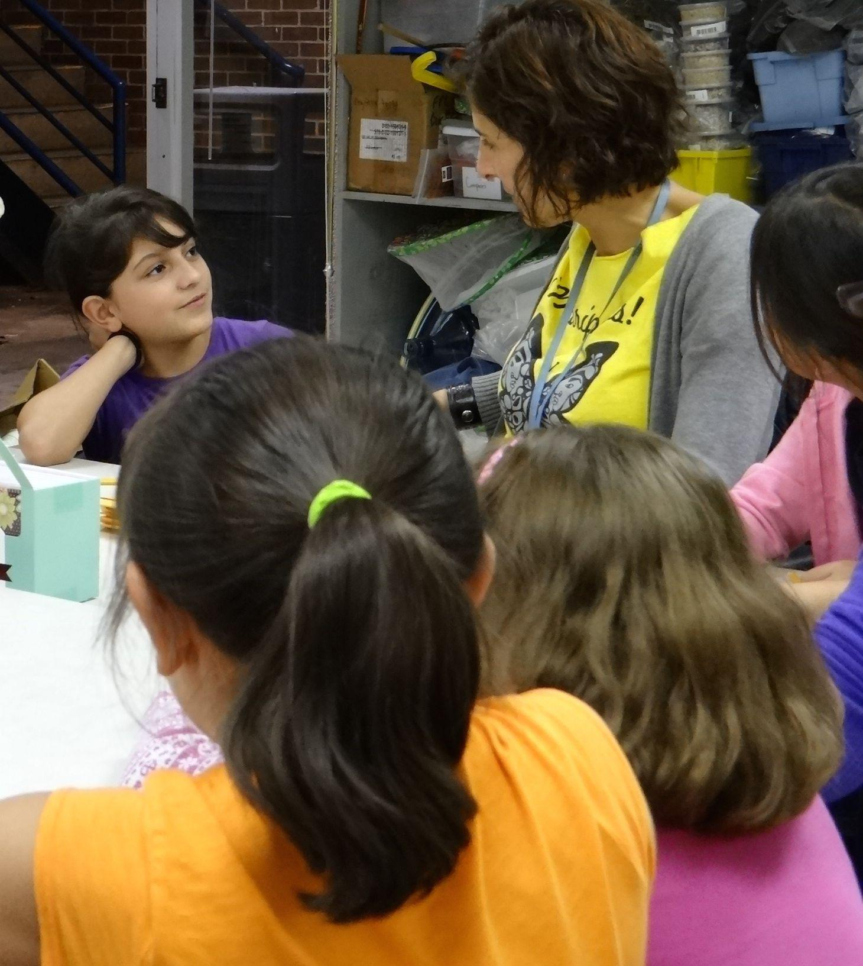
Mariposas' Curricular Focus
Determination
Personal Discipline
Curiosity
Personal Safety
Activism
Tenacity
Why WHAT How

Slide 18
Civic Ownership
Civic ownership results from a premeditated attempt to help 1st generation citizens embrace and navigate the benefits citizenship affords them.
Many Latino parents can't model ownership:
Legal status
Limited of knowledge of political system
Navigation
Language
Many parents model "second class" citizenship beliefs
Why WHAT How

Slide 19
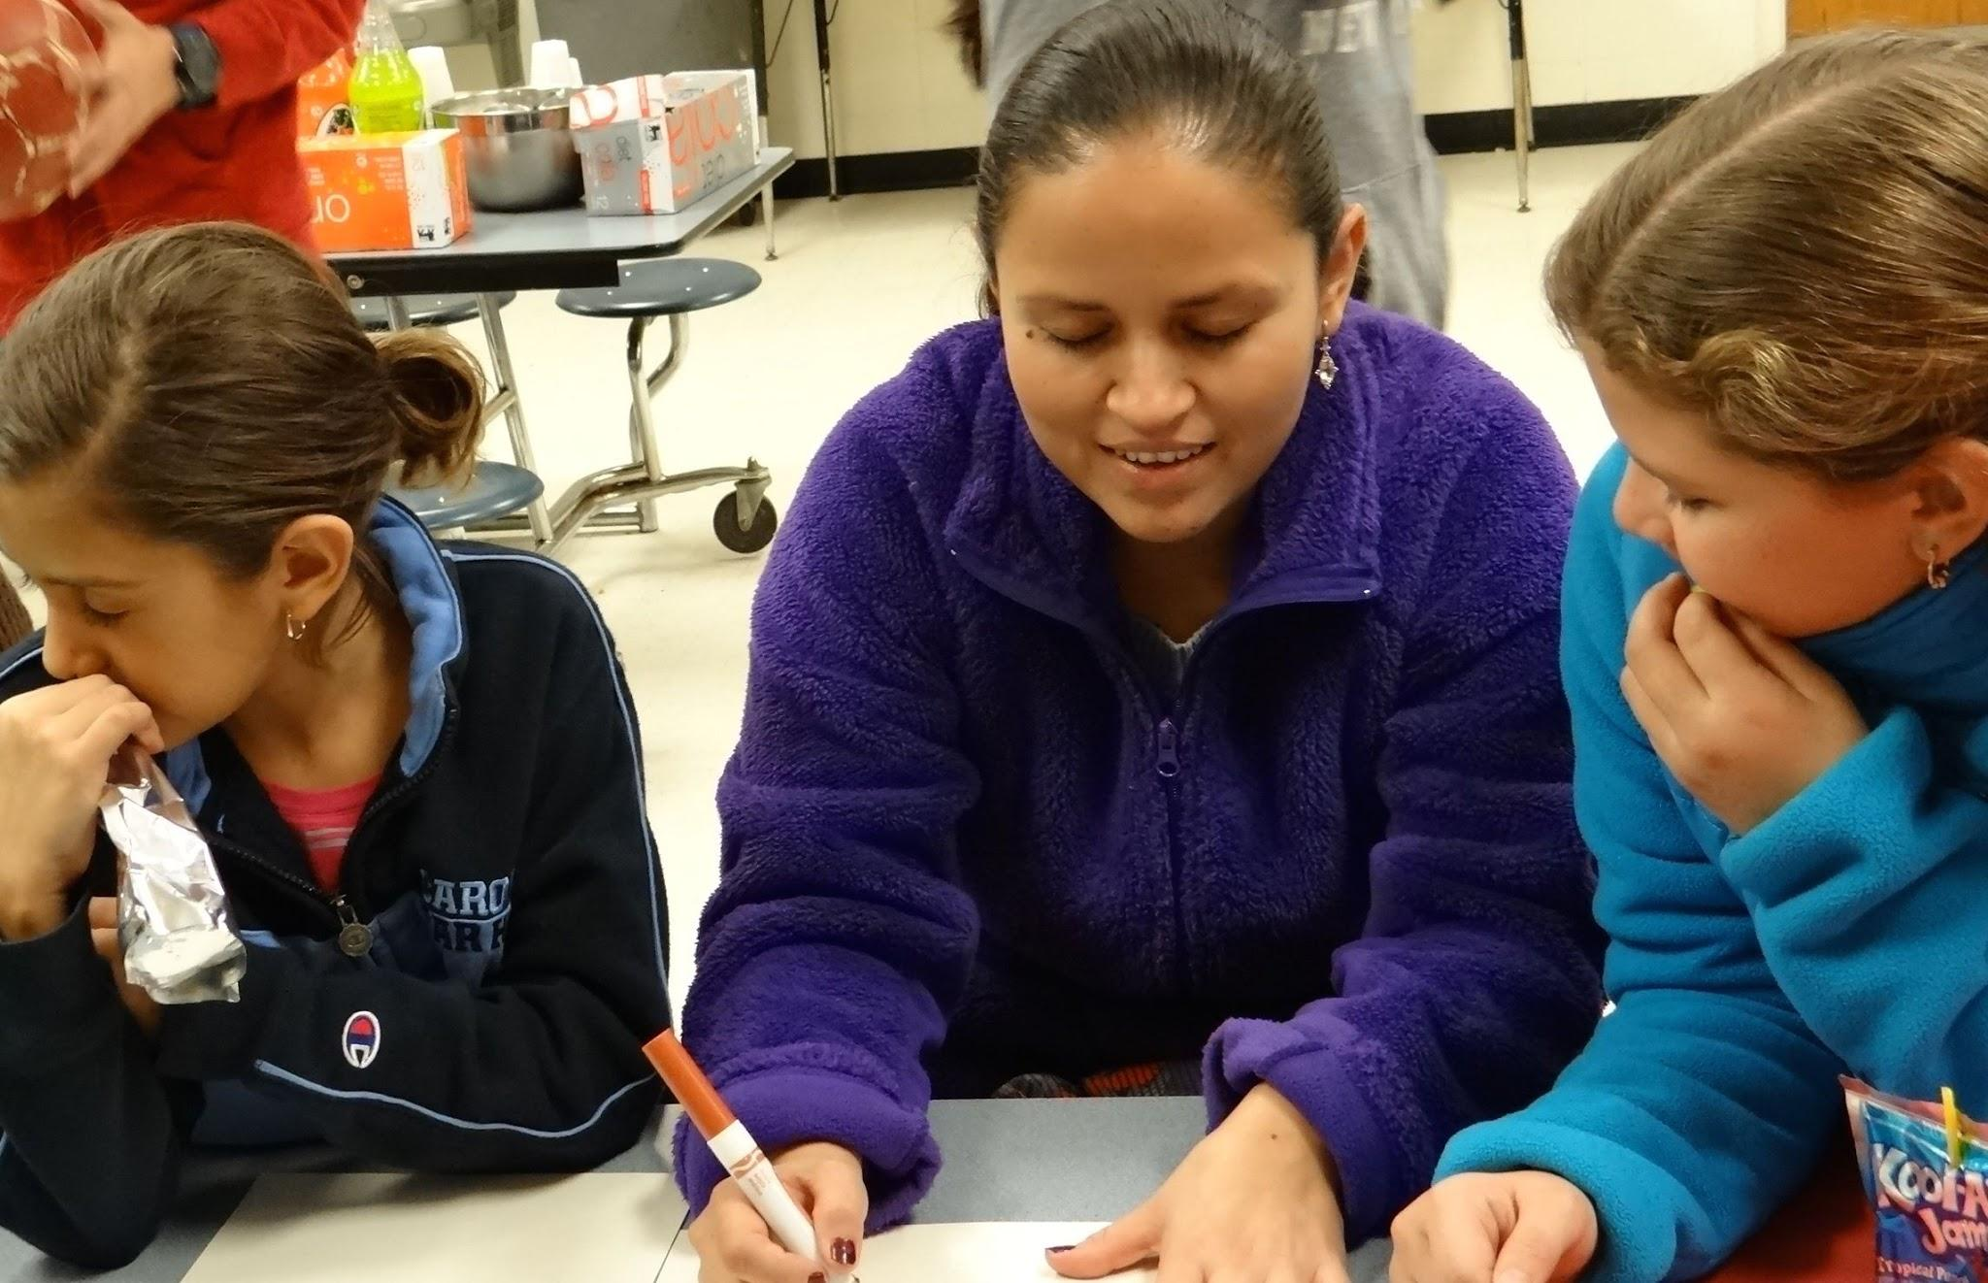
Importance of Parent Engagement
Some populations "silenced"
Critical to integrate parents' story: empowerment and sustainability
Helps shift perspectives for students and parents
Promotes communication
Strengthens commitment to group
Increases school participation
Why WHAT How

Slide 20
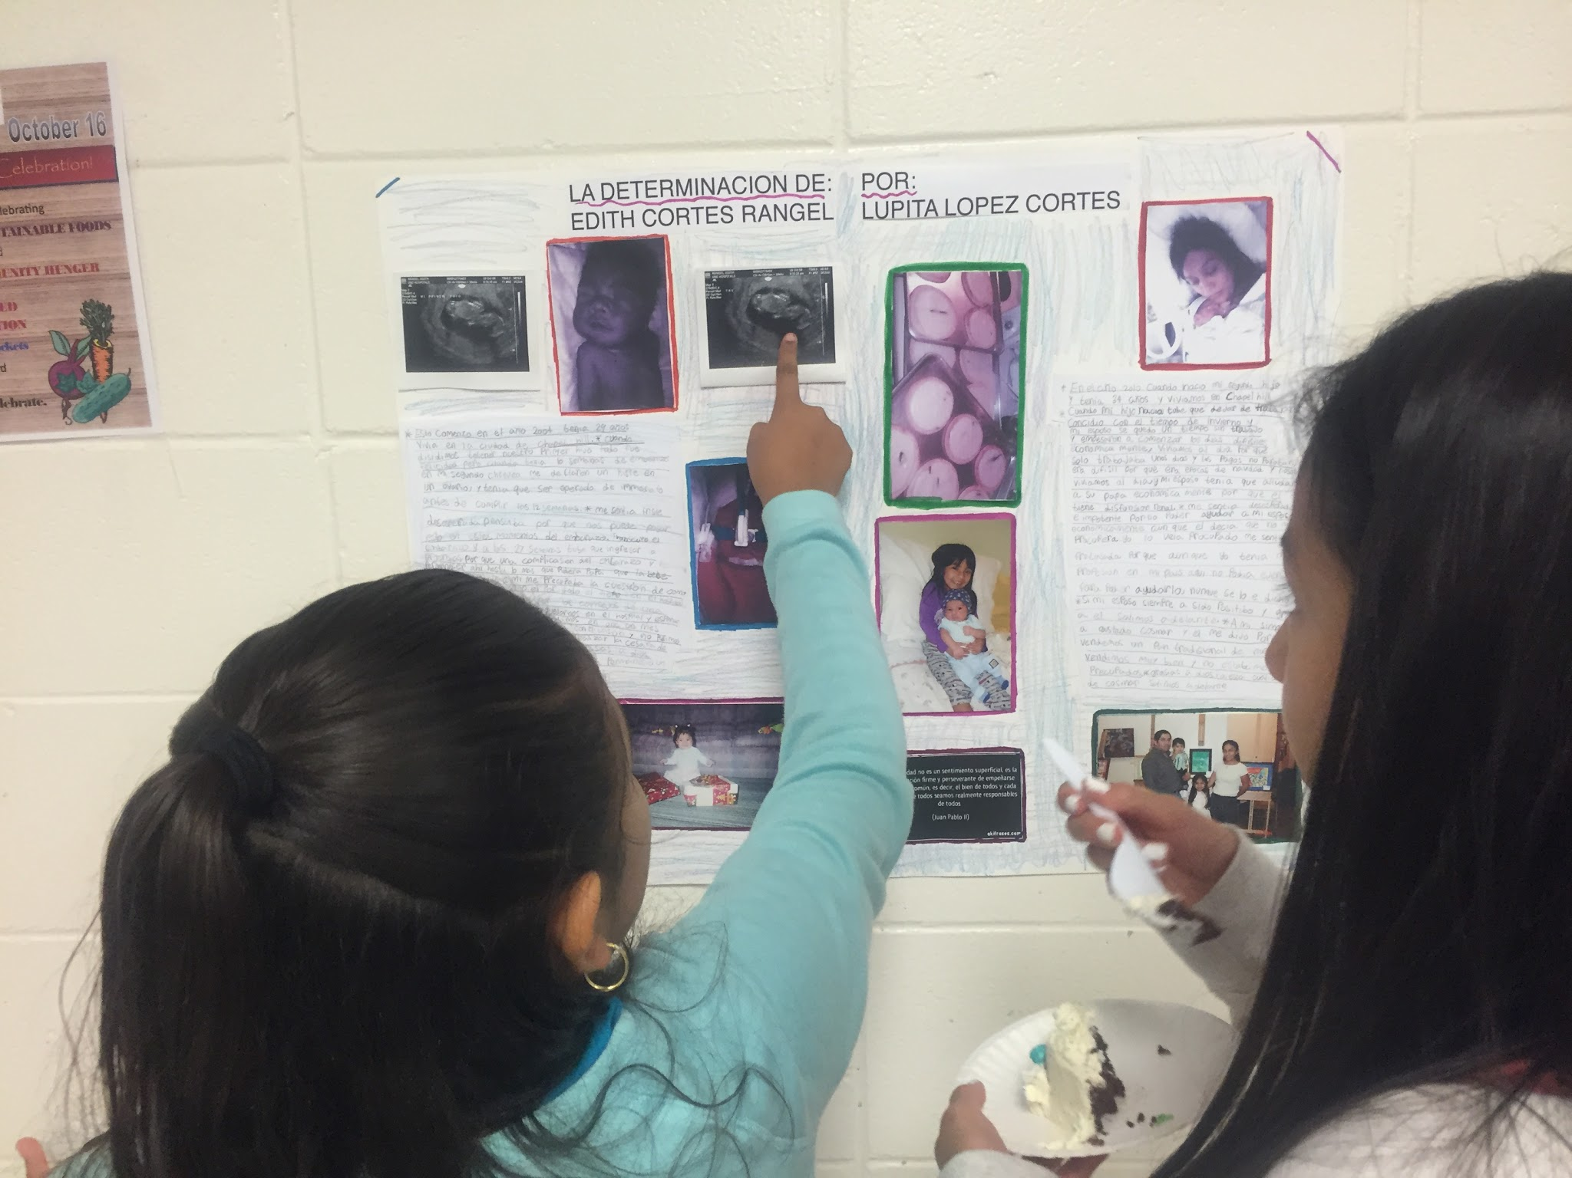
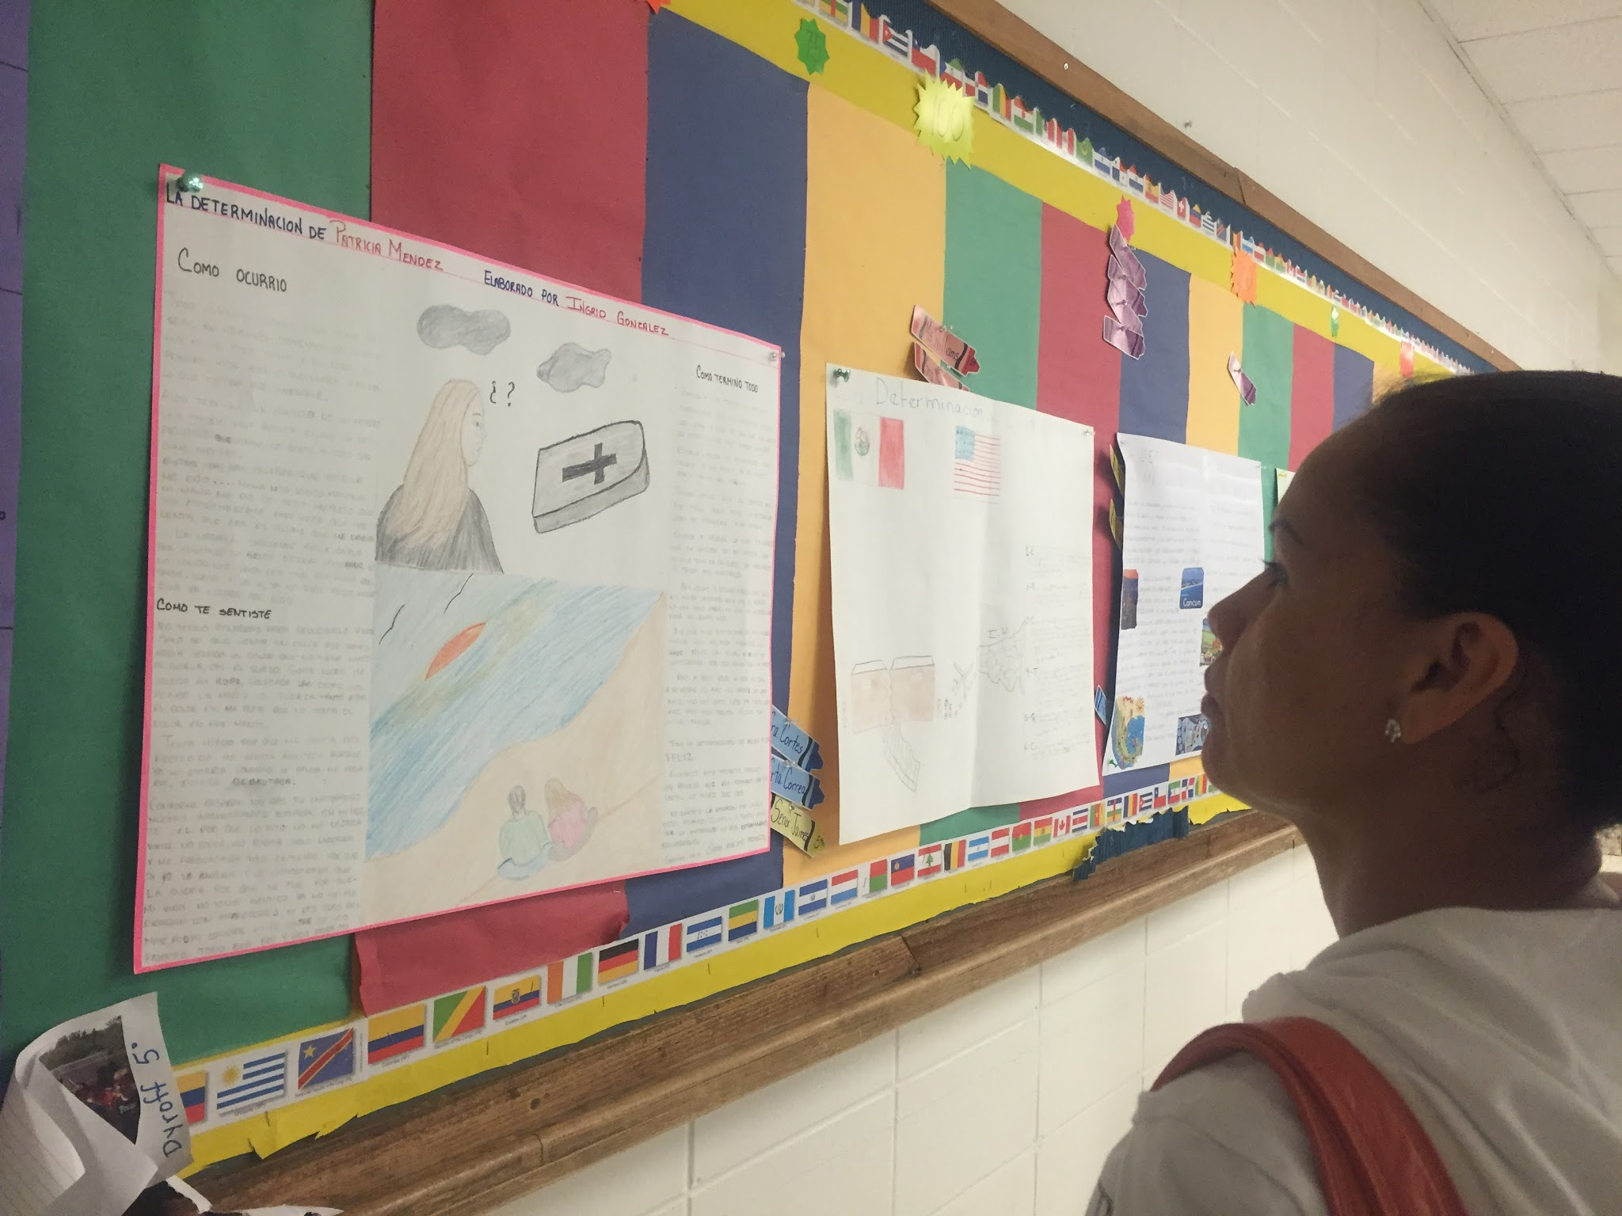
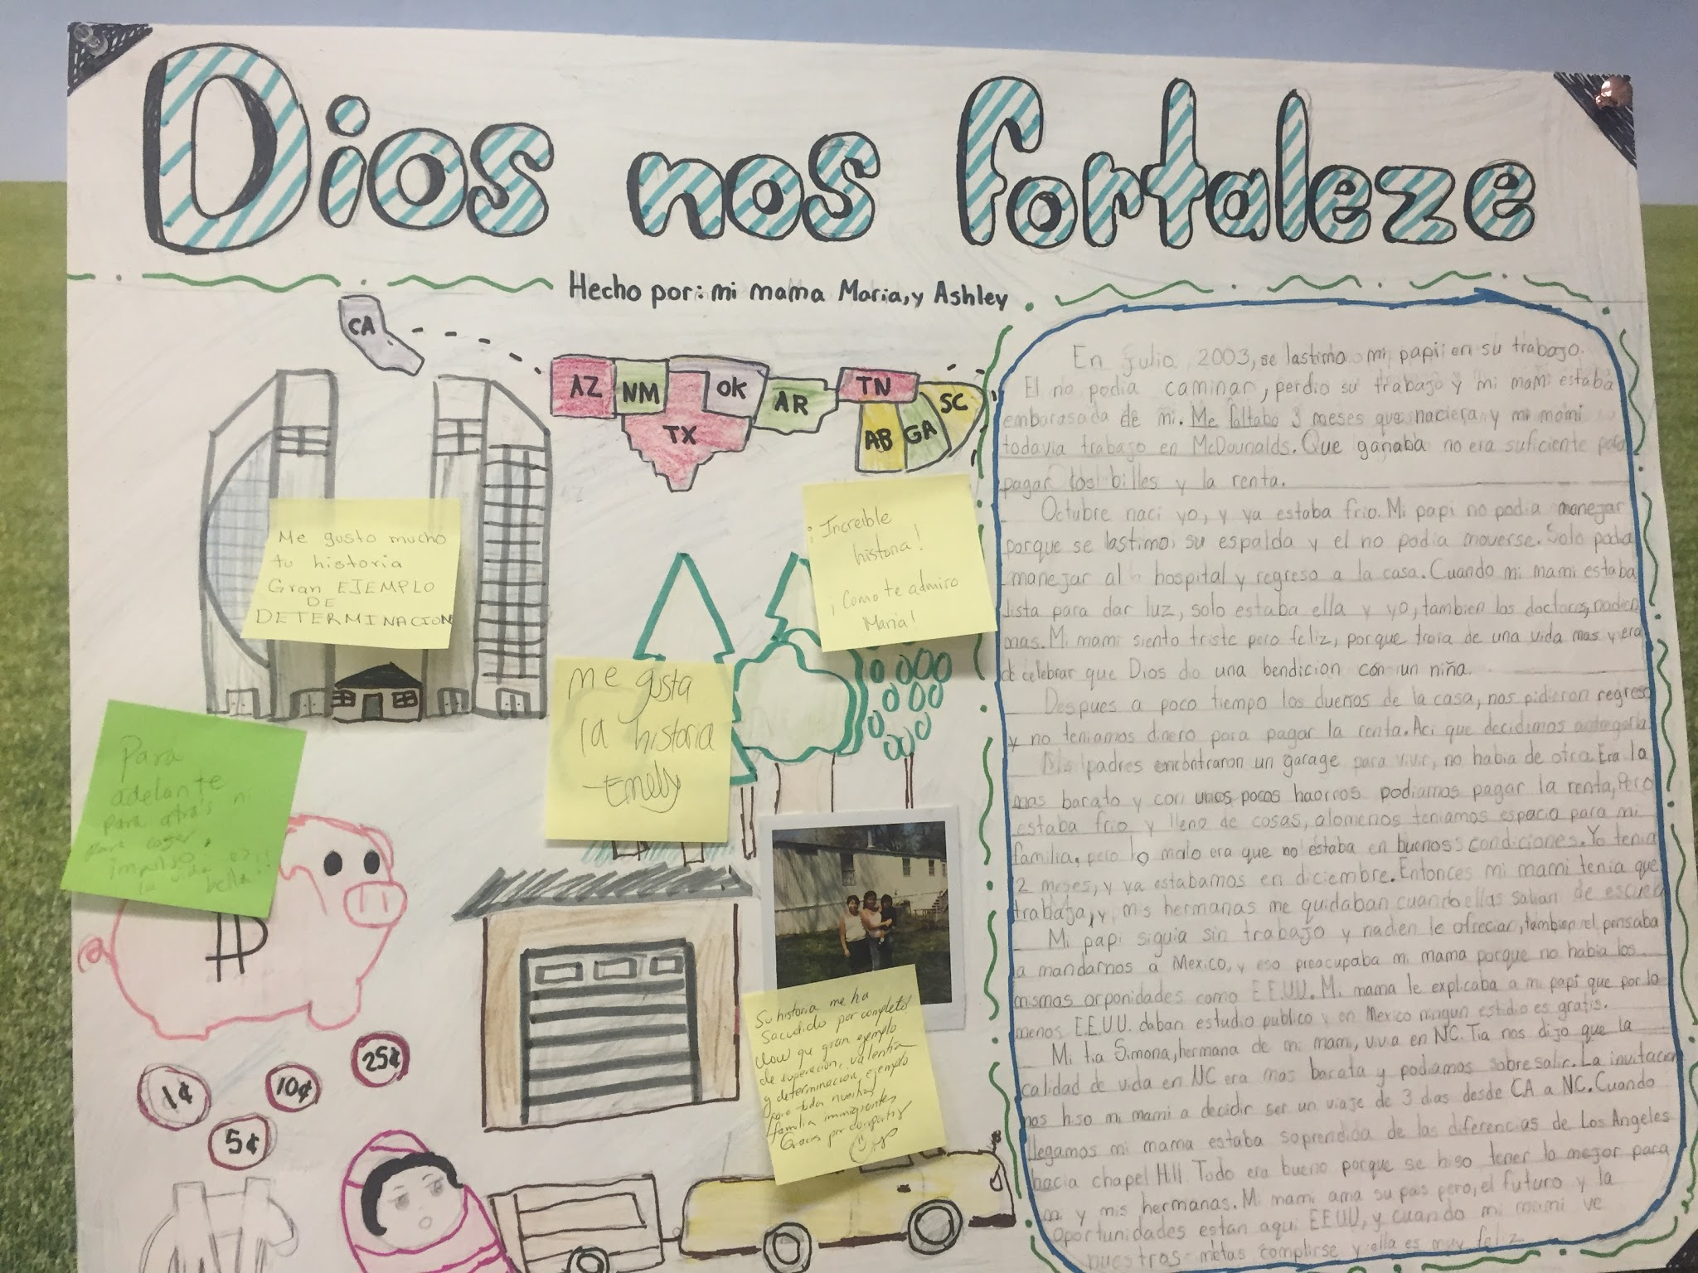
Framework in Action
Curricular Focus Civic Ownership Parent Engagement
"Determination Lives in Your Parents"
Girl Rising documentary
Parent empowerment session on role of their stories
Collaborative project
Gallery night

Slide 21
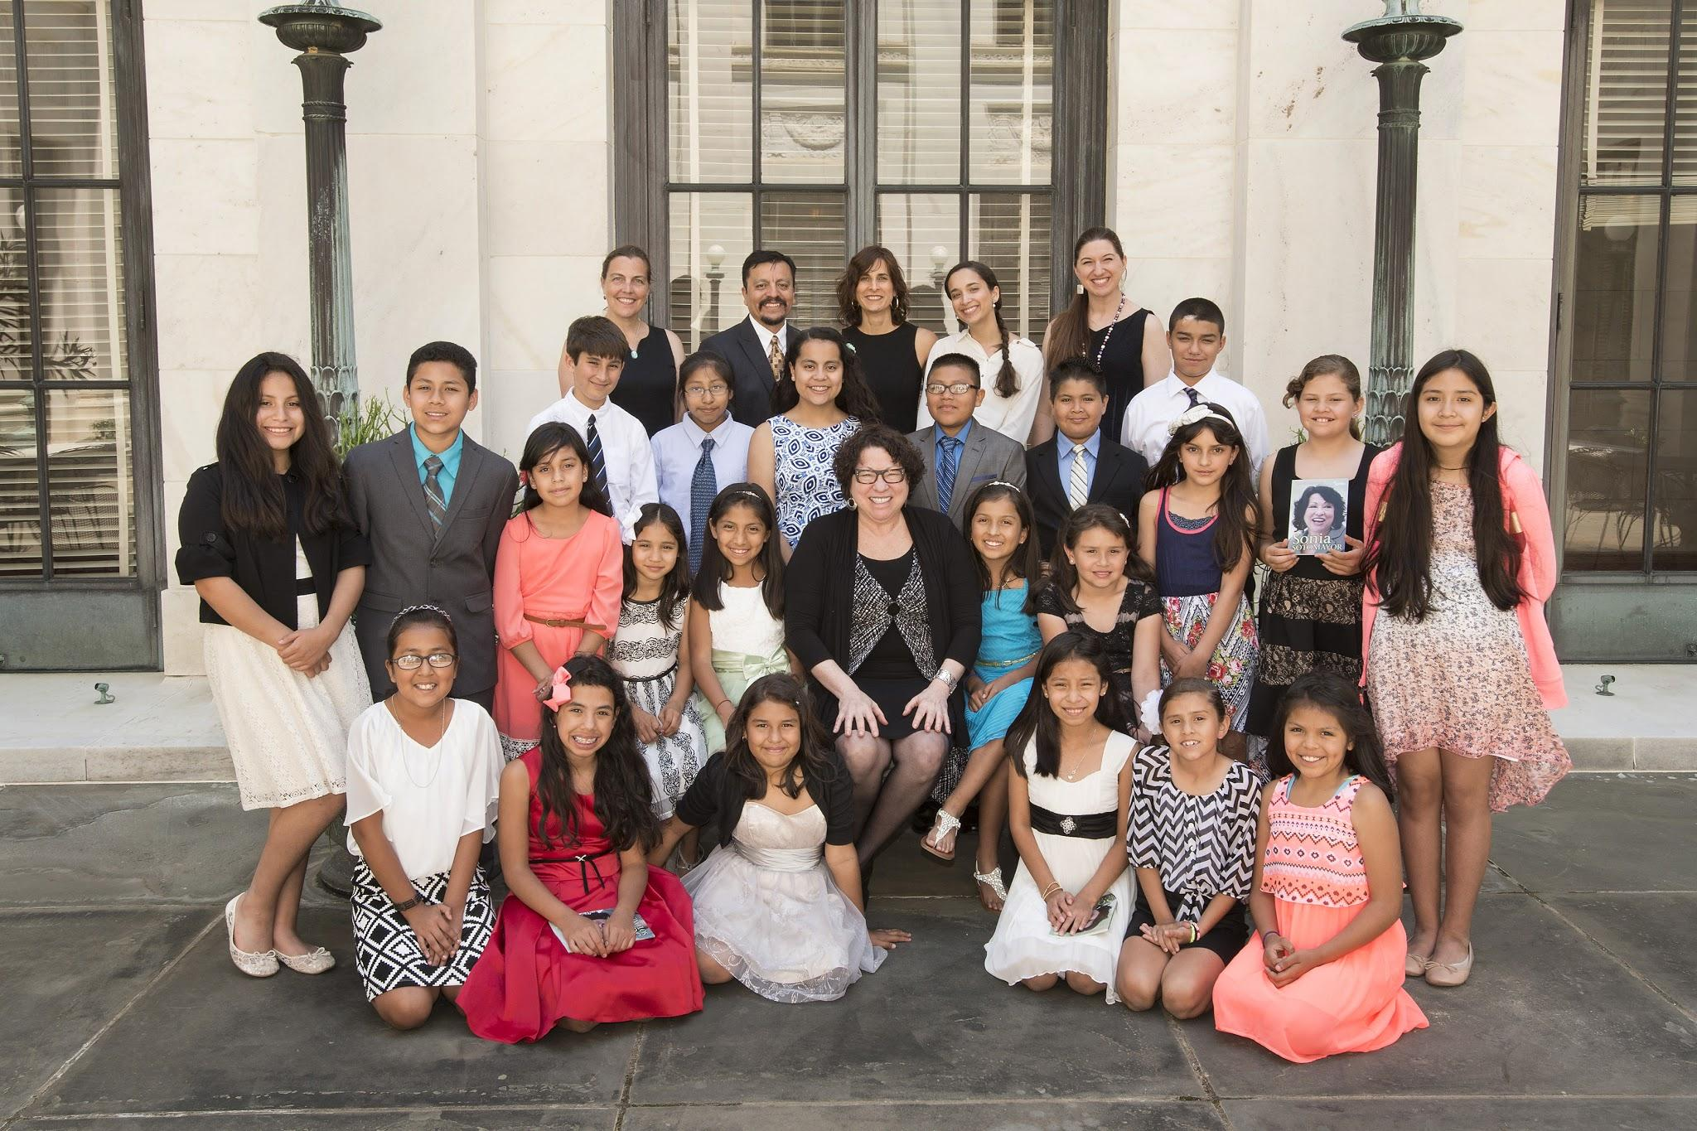
Framework in Action
Curricular Focus Civic Ownership Parent Engagement
Sonia Sotomayor
Familia y Patria
Adversity
Resilience
Code Switching
Why WHAT How

Slide 22
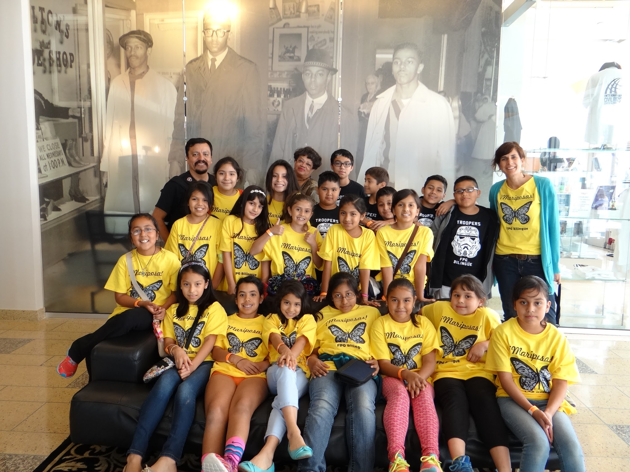
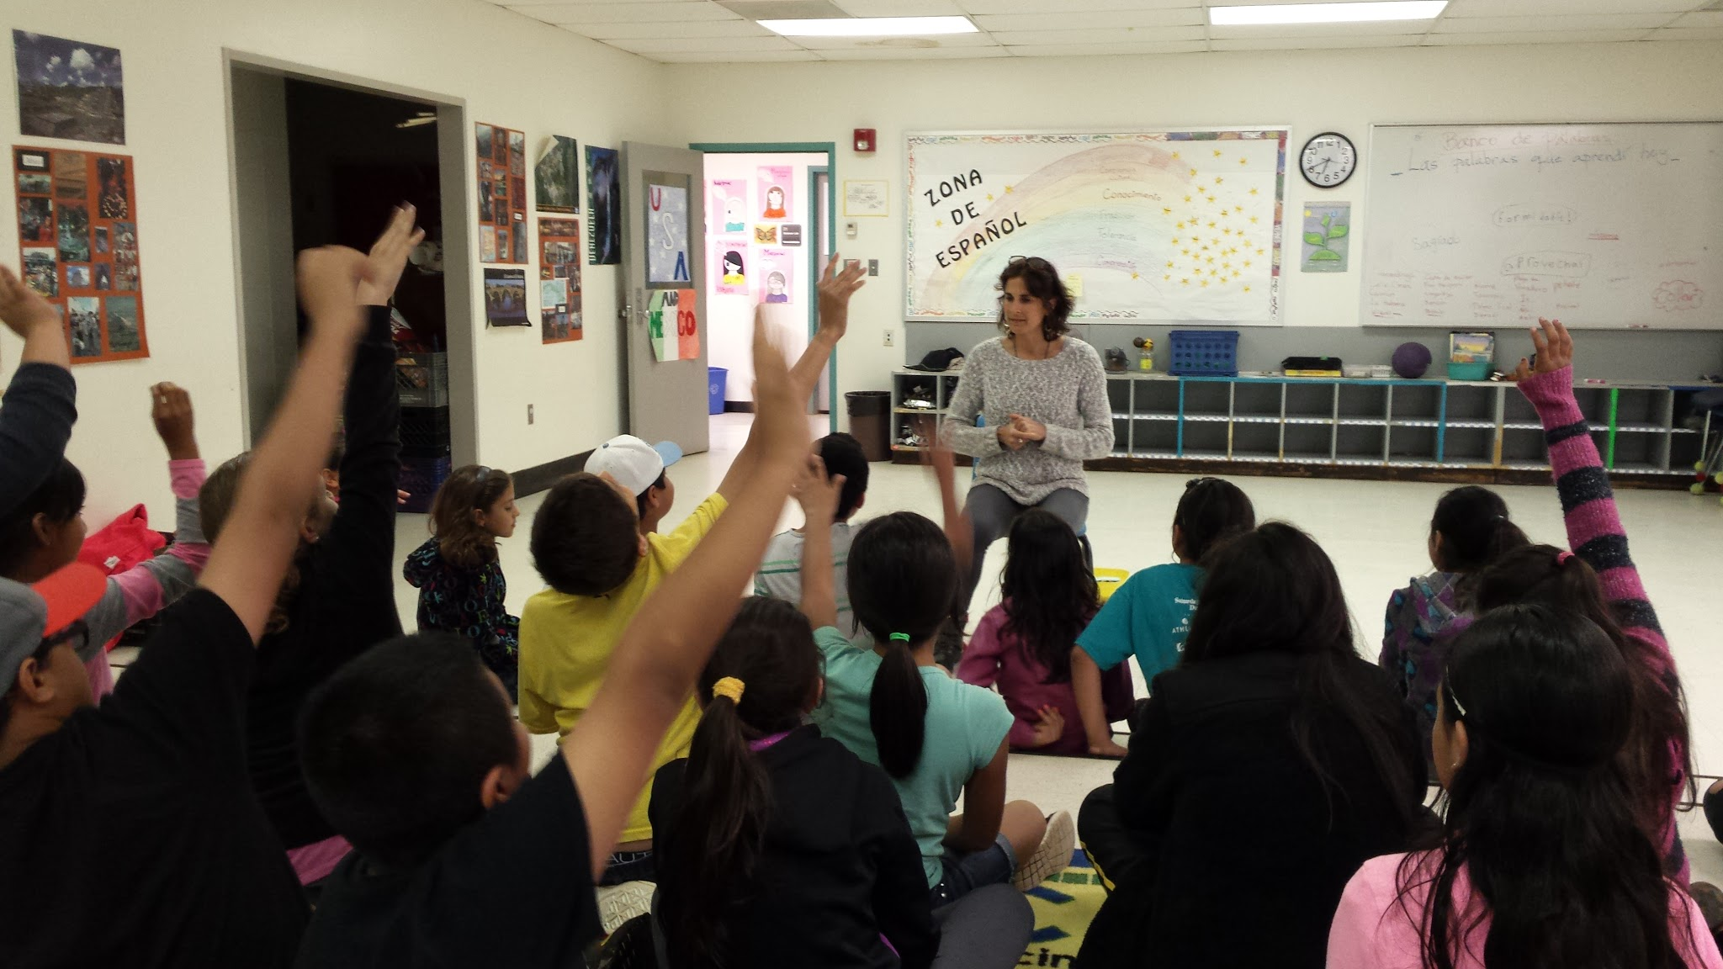
Framework in Action
Curricular Focus Civic Ownership Parent Engagement
"The AA Struggle is OUR Struggle"
Jim Crow
Children's March
Montgomery Bus Boycott
MLK
Malcolm X
Voting Rights
Why WHAT How

Slide 23
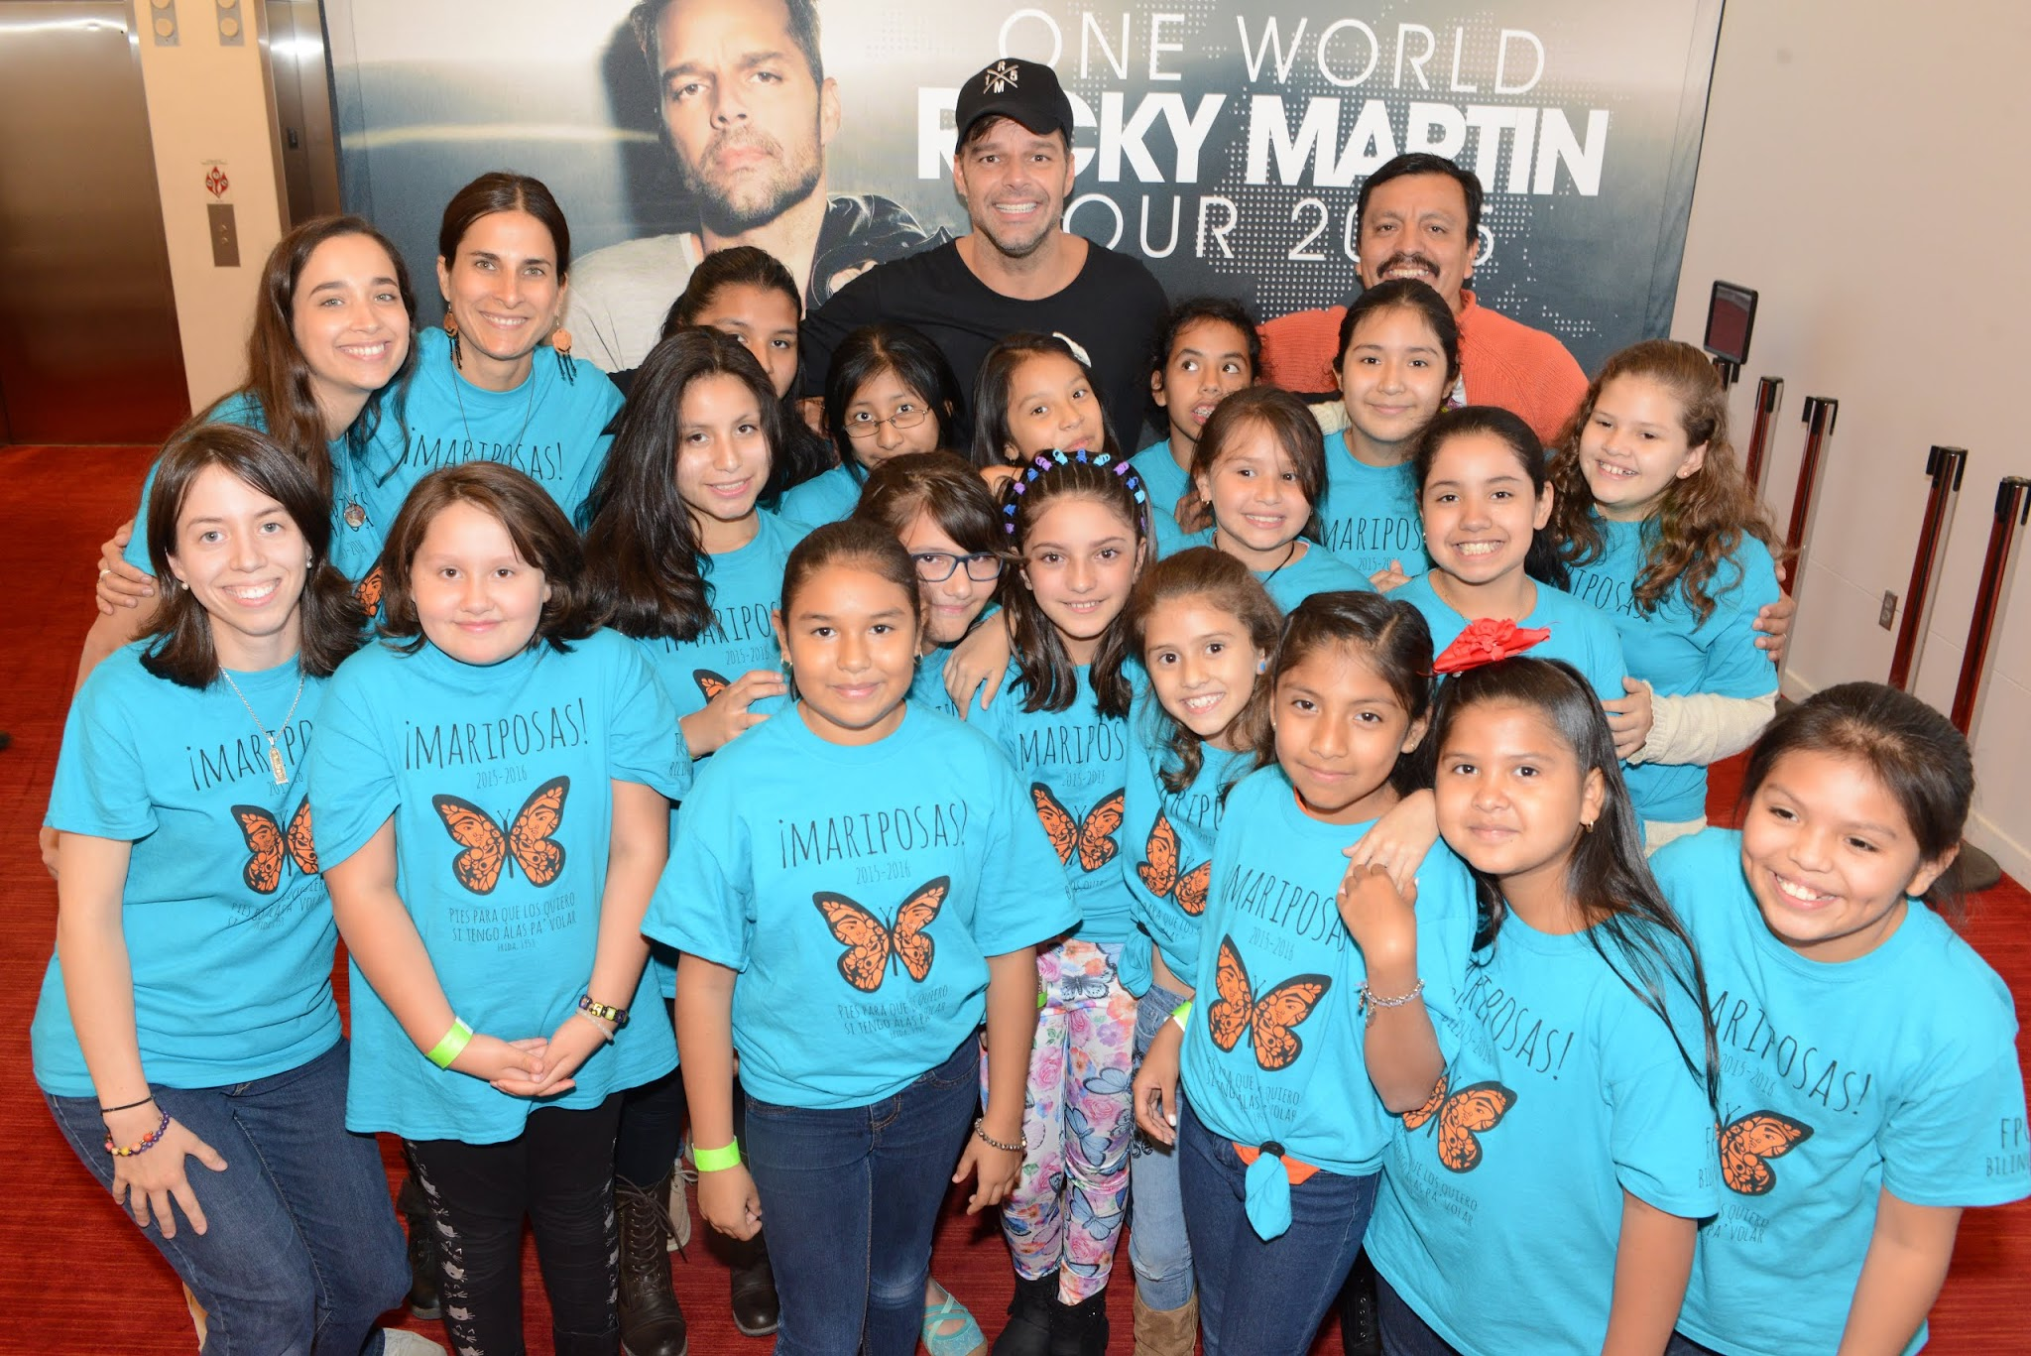
Framework in Action
Curricular Focus Civic Ownership Parent Engagement
Ricky Martin:
Biography
LGBTQ rights
LGBTQ youth issues
Gay marriage
Why WHAT How

Slide 24
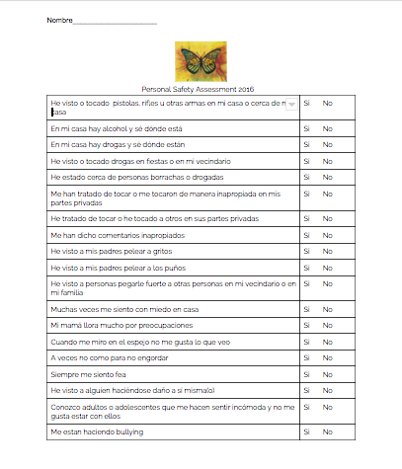
Personal Safety
Non-negotiable
Risk survey should include suicide ideation, sexual abuse, bullying, body image, drug exposure, sexual safety, gender identity issues, domestic violence, etc
Stable support system required
Why WHAT How

Slide 25
Data Sharing with Parents
Data literacy gap for some populations
Program ideal platform to develop data literacy
Parents provided with easy to understand data at MOY (two-year trajectory)
Parents provided with clear strategies to help
Students provided with clear expectations to improve
Parents/ students hold each other accountable
Expedited academic counseling referrals

Slide 26
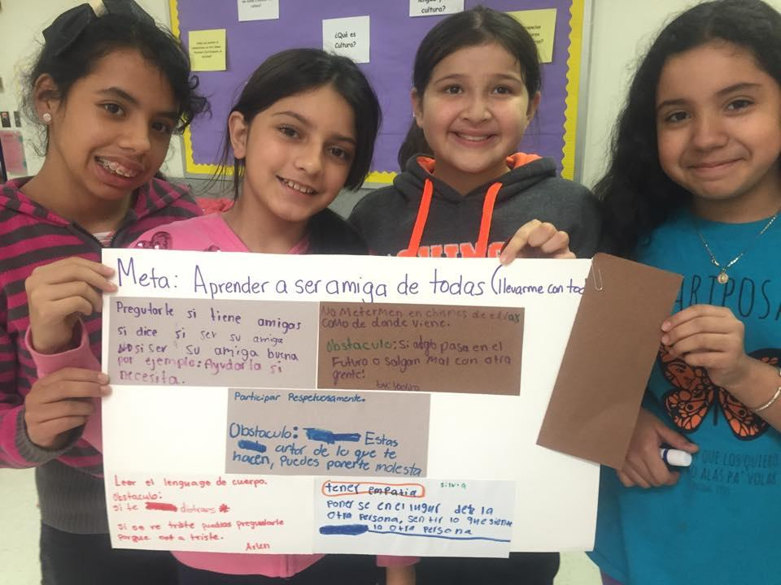
How

Slide 27
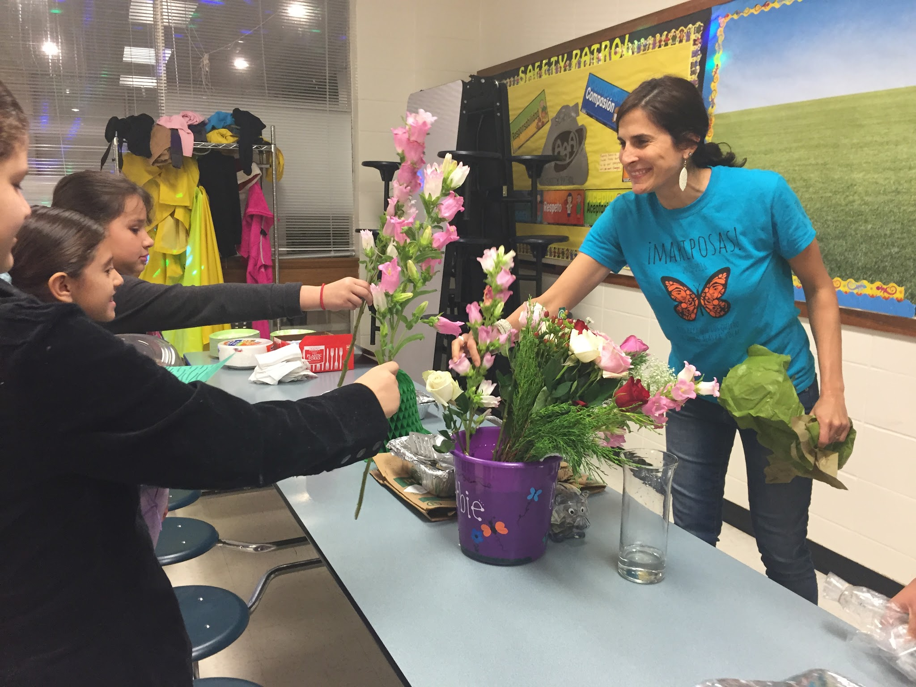
Coordinator
Analytical and Data-driven (needs assessments, pre/post data, academic data, discipline data)
Knowledgeable of socio-emotional needs of targeted group
Knowledgeable of socio-emotional health issues
Knowledgeable of "macrosystem" issues that impact targeted group
Knowledgeable of historical context of targeted group
Why What HOW

Slide 28
Coordinator's Data Literacy
Must have access to data
Identify relevant data
Data tracking (BOY, MOY, EOY)
Anecdotal data (teacher, social worker, counselor, parents)
Communication with teachers
Why What HOW

Slide 29
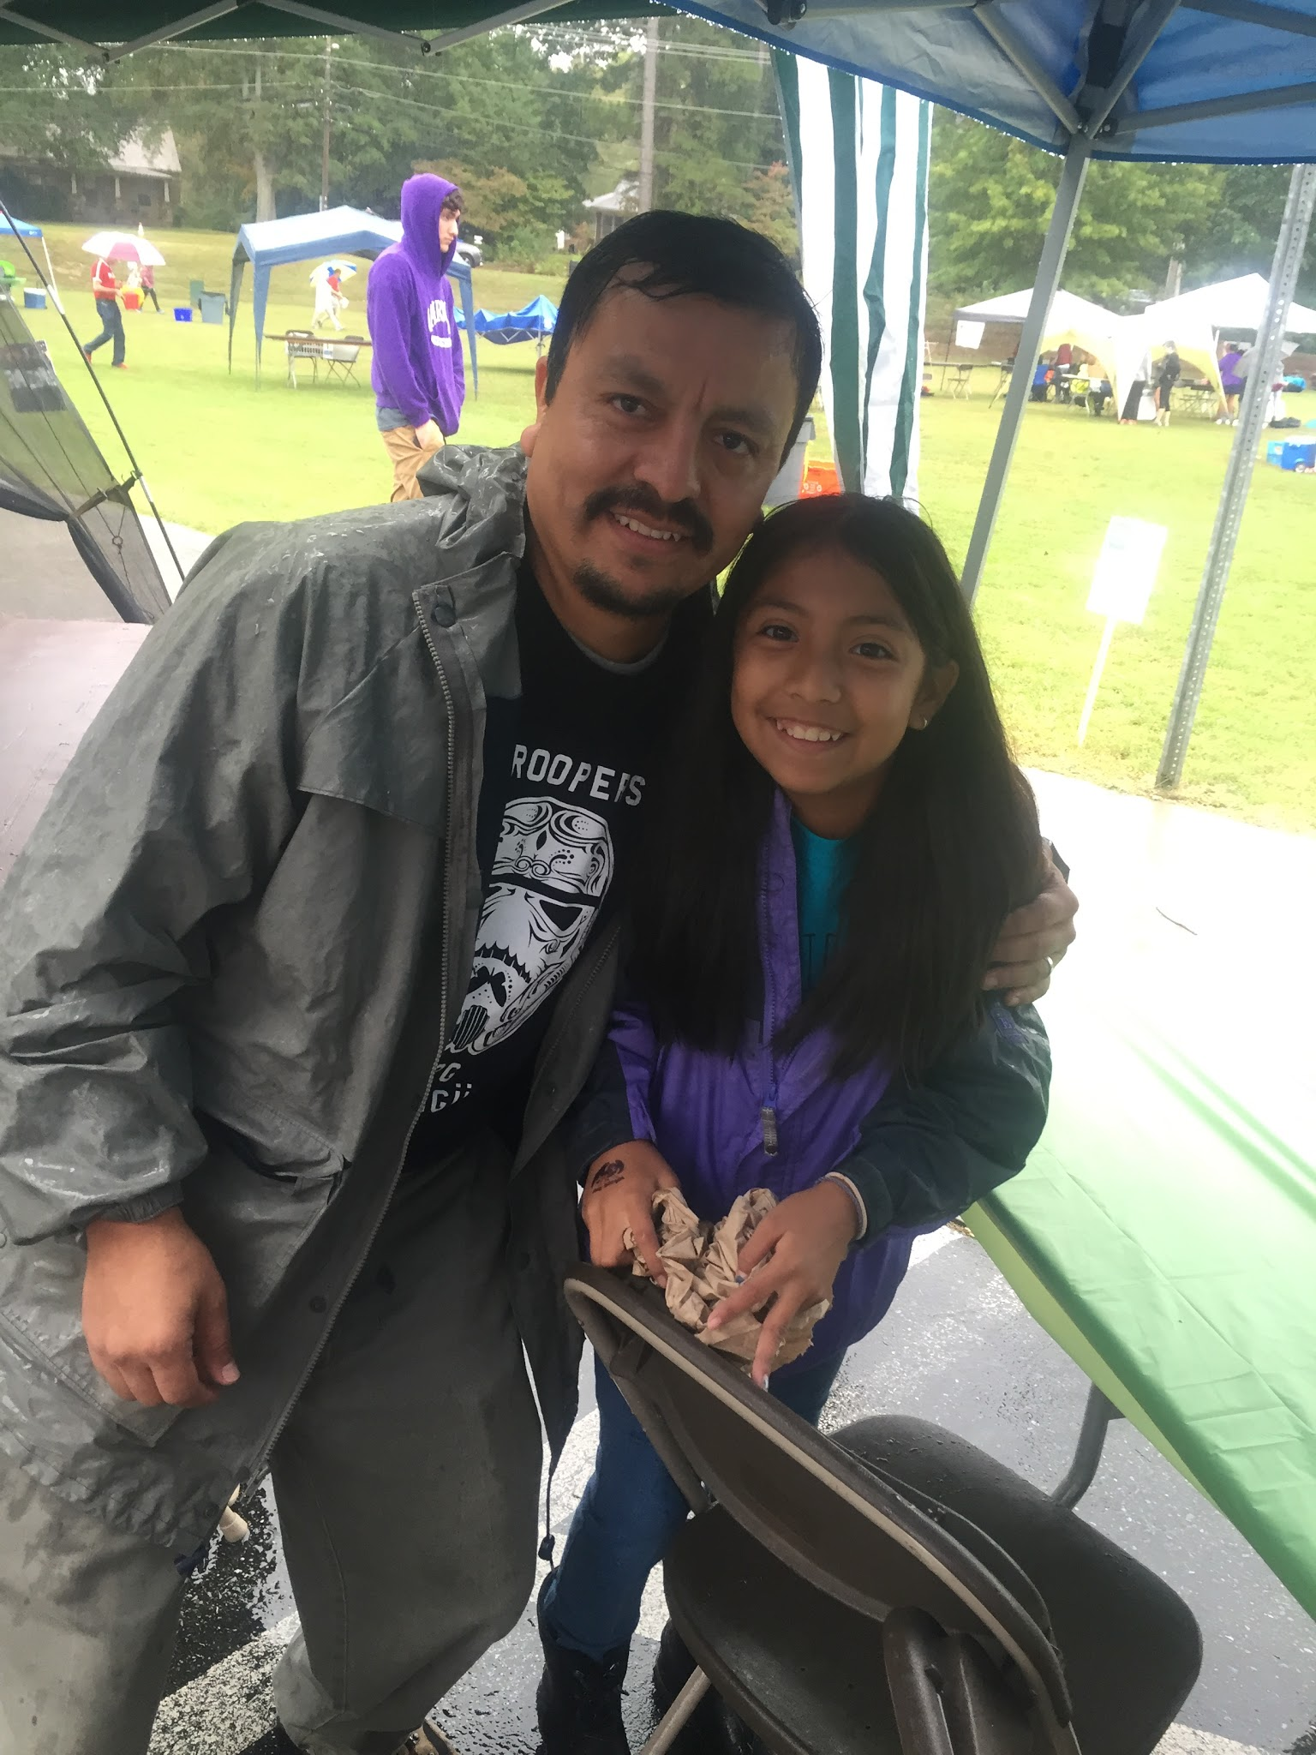
Administrative Support
Start small! First year is about trust building
Embrace transparency: share a clear vision, mission and action plan at BOY. Share data, challenges and accomplishments at EOY
Avoid the virtue of obscurity
Be consistent
Help transfer parent engagement to wider school
Why What HOW

Slide 30
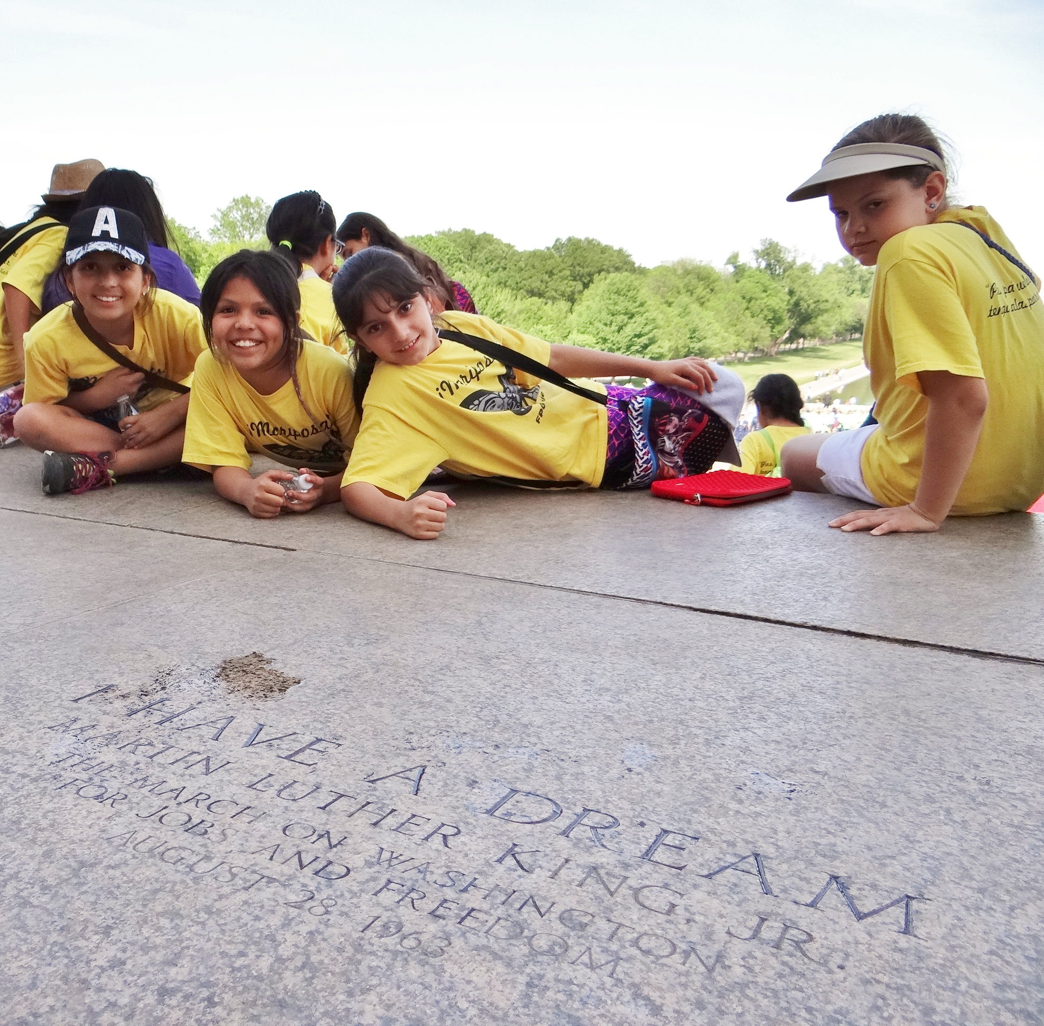
Targeting Your Students
Academic data
Discipline data
Anecdotal data
Consider each student's ecology carefully
Consider parental capacity for commitment
Why What HOW

Slide 31
Parent Information Meeting
Childcare
Short needs assessment
Take-home packet
Visually engaging slides
Present targeted group data to parents (educational, socioemotional, etc)
General overview of curriculum
Requirements to be part of the group
It's an application, not a registration
First meeting is about warm urgency and trust
Why What HOW

Slide 32
Technology
Text, Whatsapp, FB access in application
Photo/video consent in application
Facebook group
Twitter
Why What HOW

Slide 33
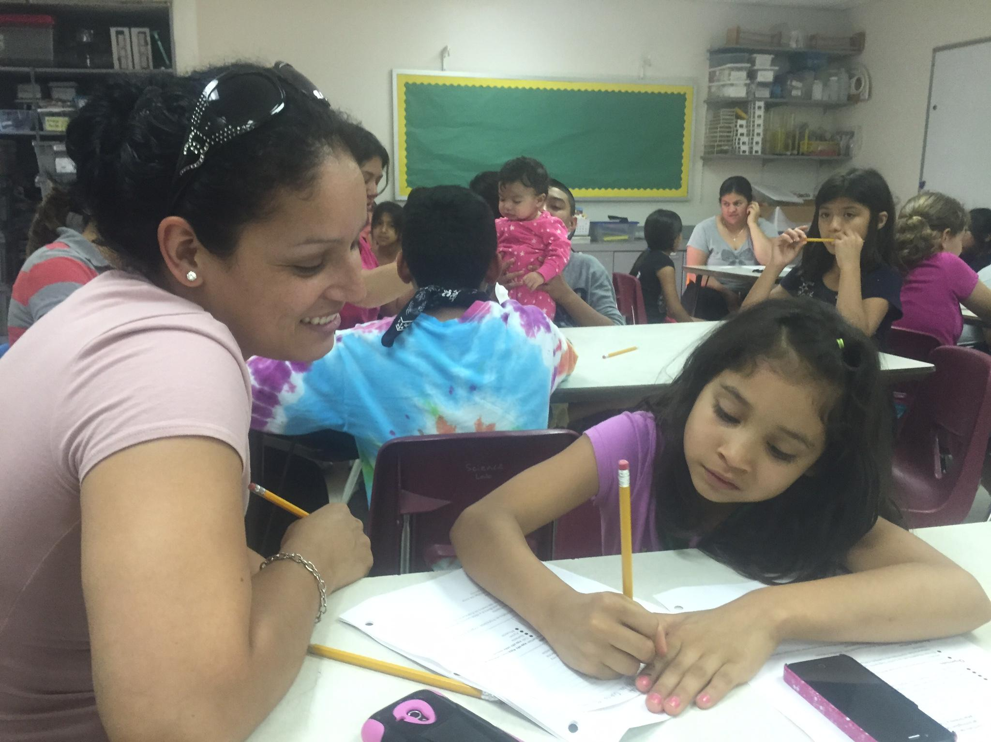
Challenges
Funding
Staffing
Time
Space
Following students
Why What HOW

